Slide 1
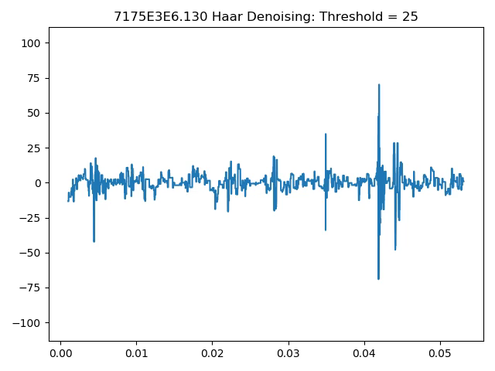
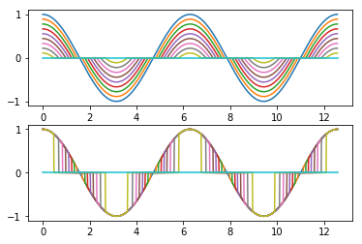
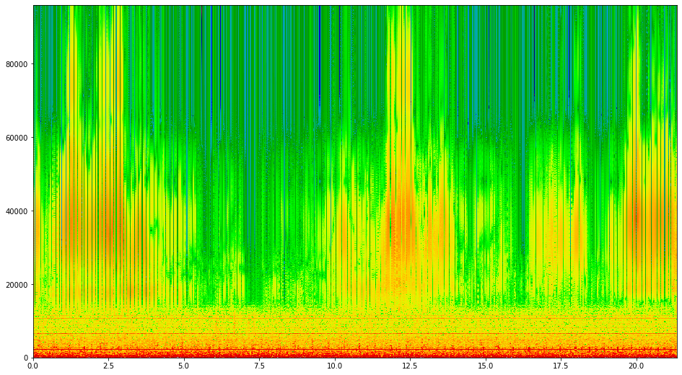
Defense of Master’s for Applied Physics An overview of data science techniques applied to LADC-GEMM data with wavelet applications.
Michael Haas
10/16/2019
Major professor: Dr. Juliette Ioup
Committee members: Dr. Puri, Dr. Malkinski

Slide 2
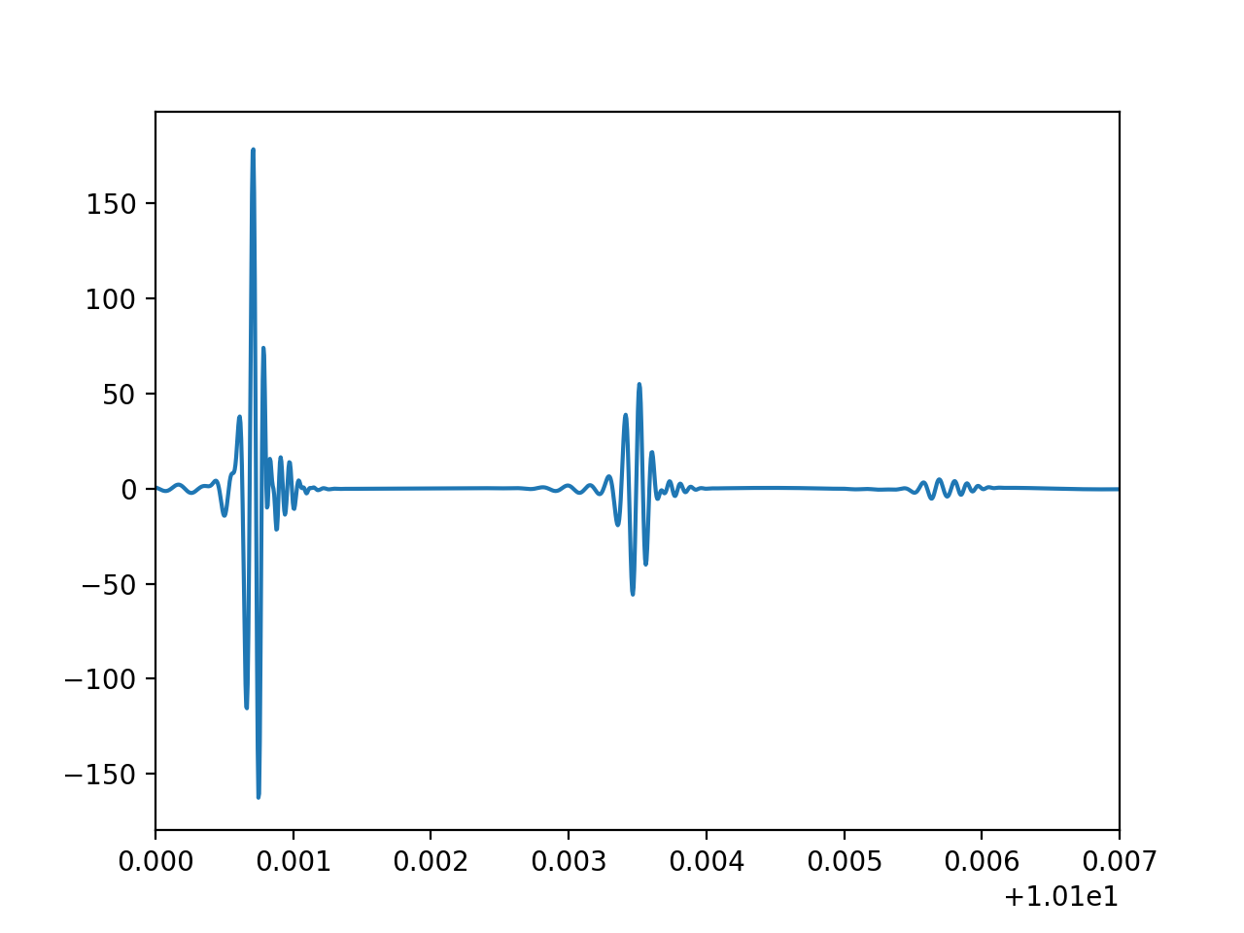
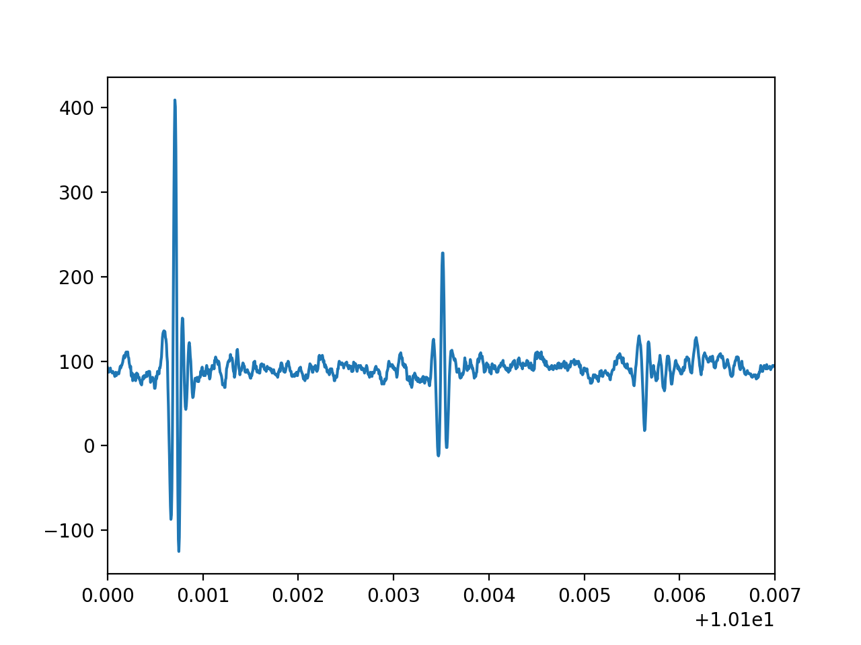
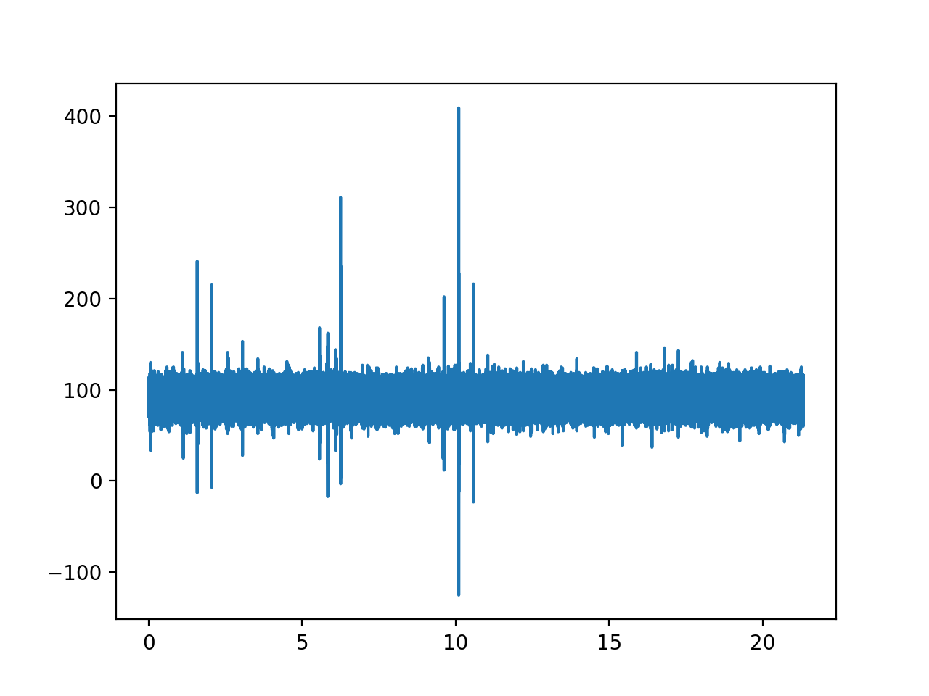
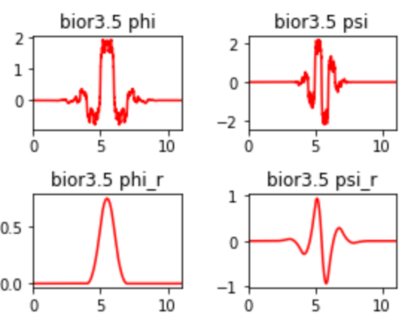
Topics:
LADC data
Wavelets
Automatic Searching Algorithm (WIP)
LIGO Based Clustering Algorithm (WIP)

Slide 3

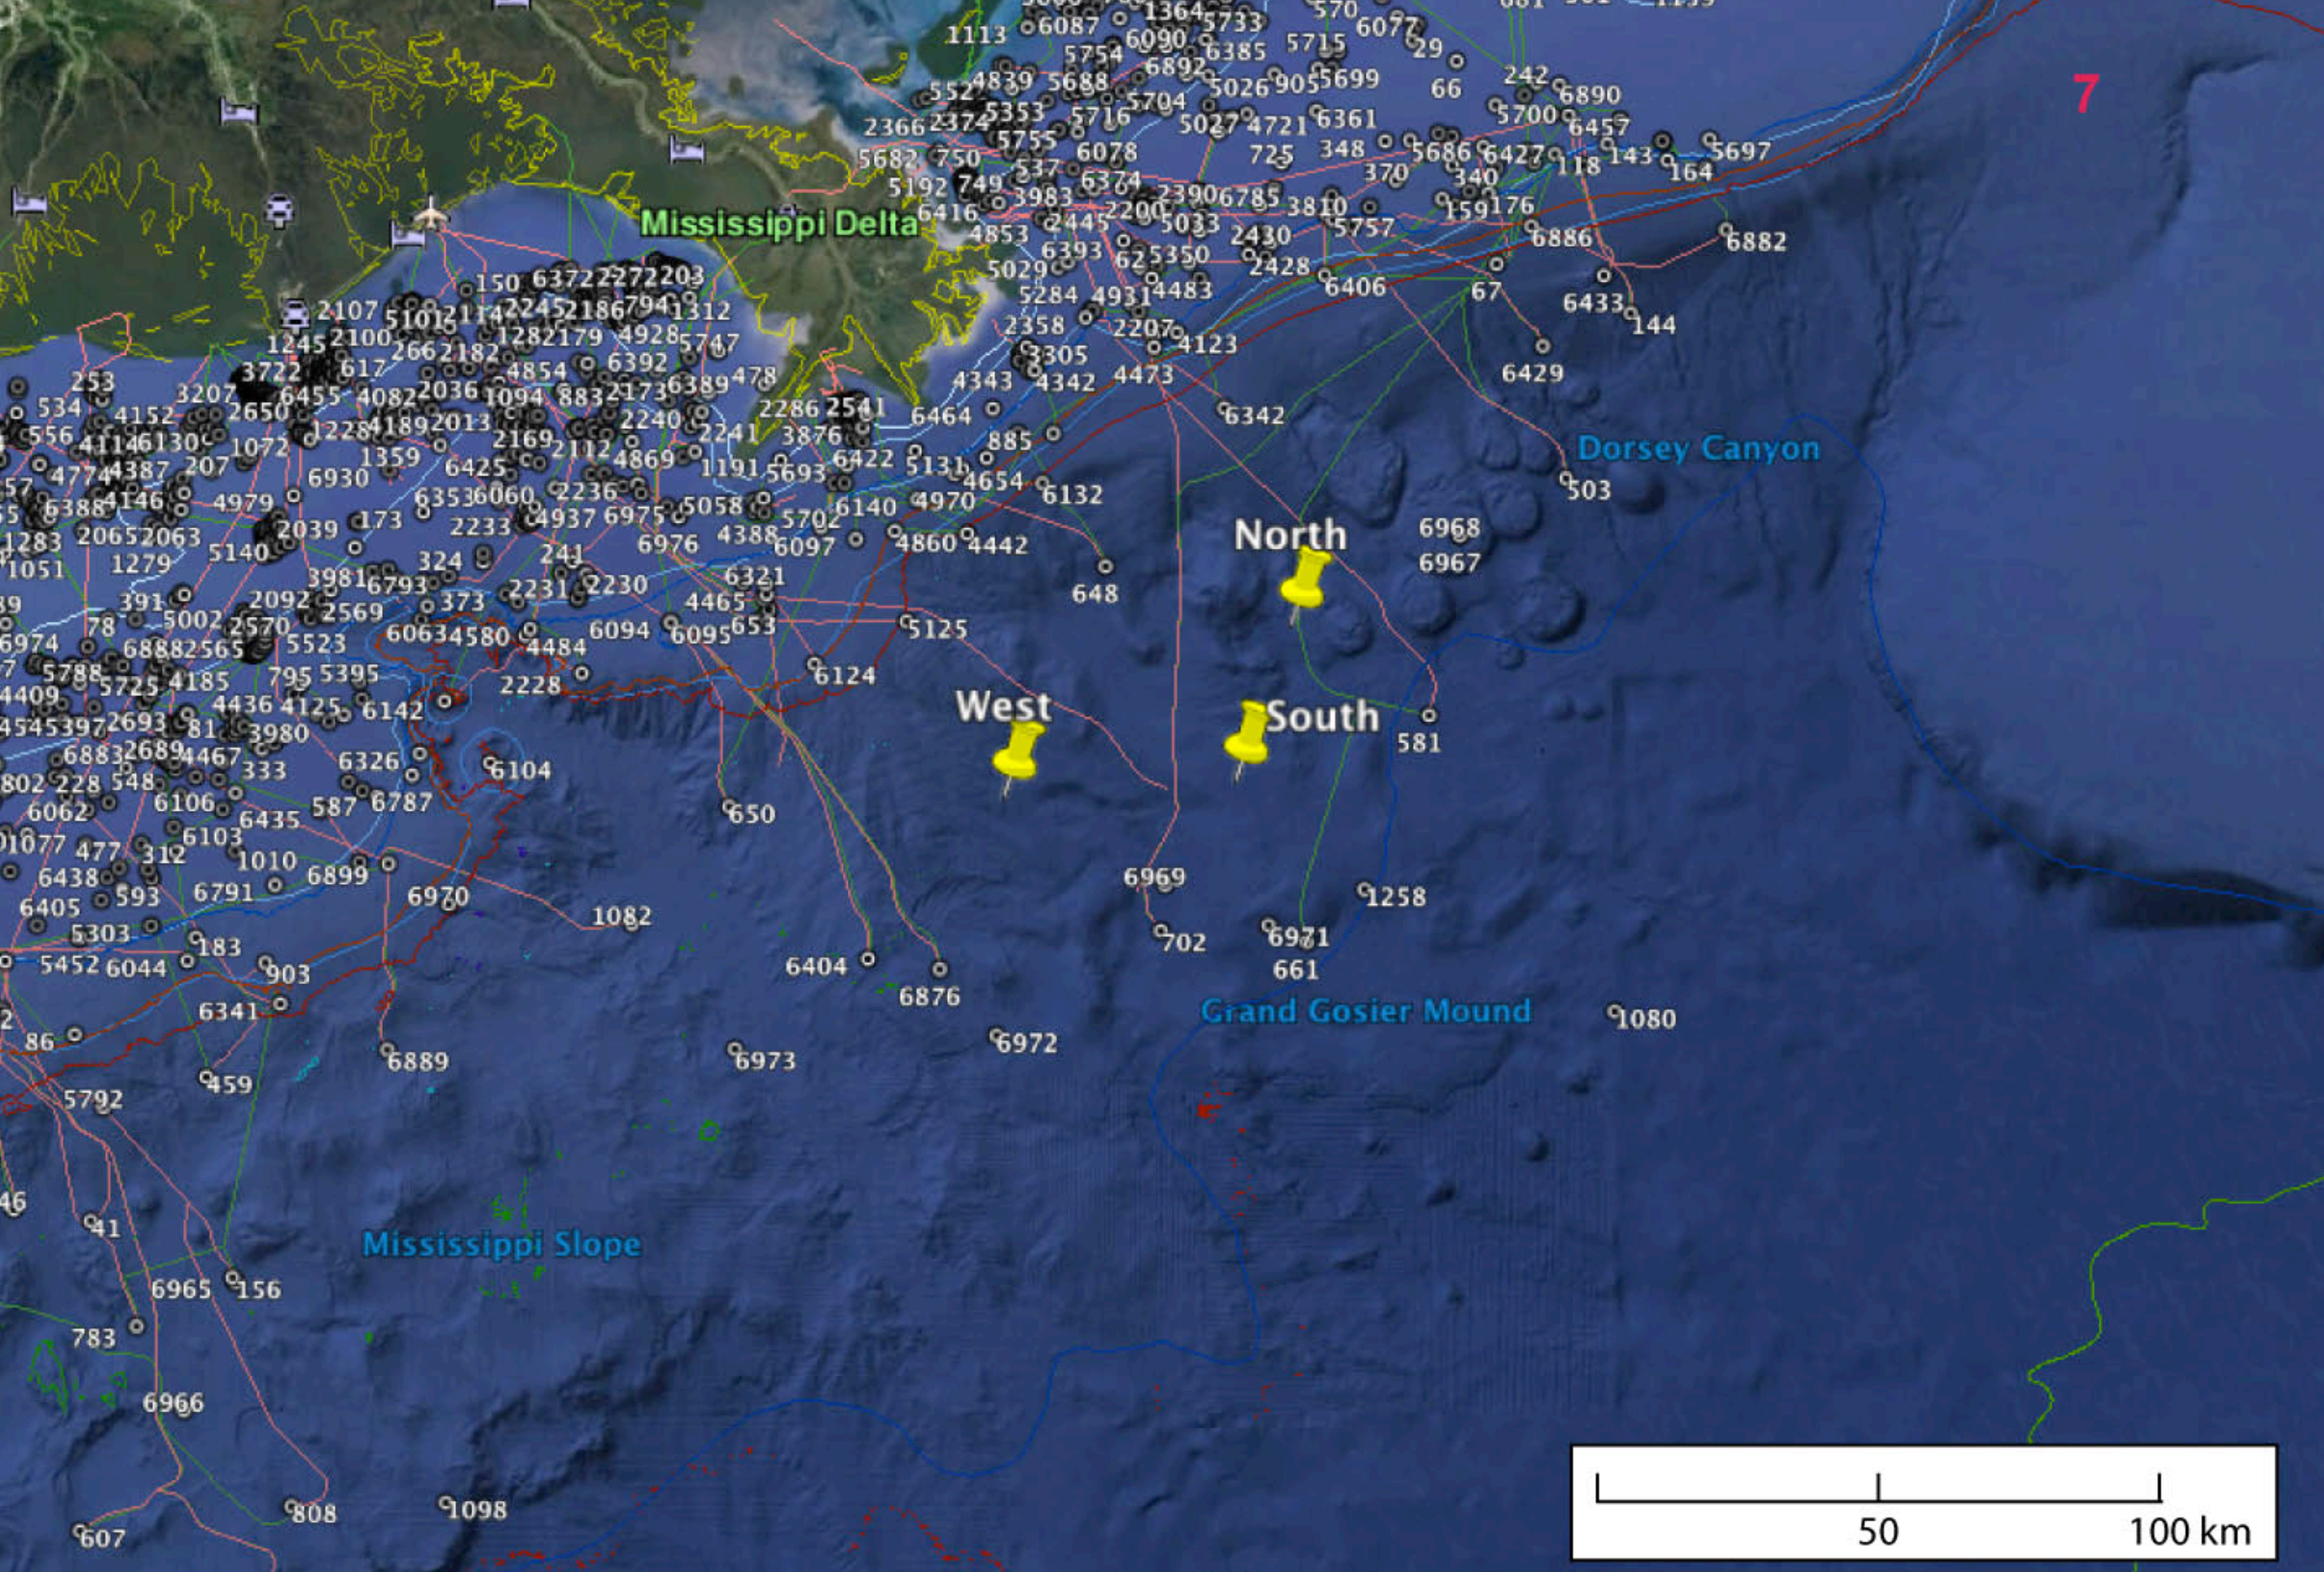
LADC Data – lots of it…
Multiple years of deployments
Multiple months per deployment
Multiple buoys per deployment
Multiple hydrophones per buoy
Hi-def, 192kHz sampling rate
> 10’s of terabytes

Slide 4
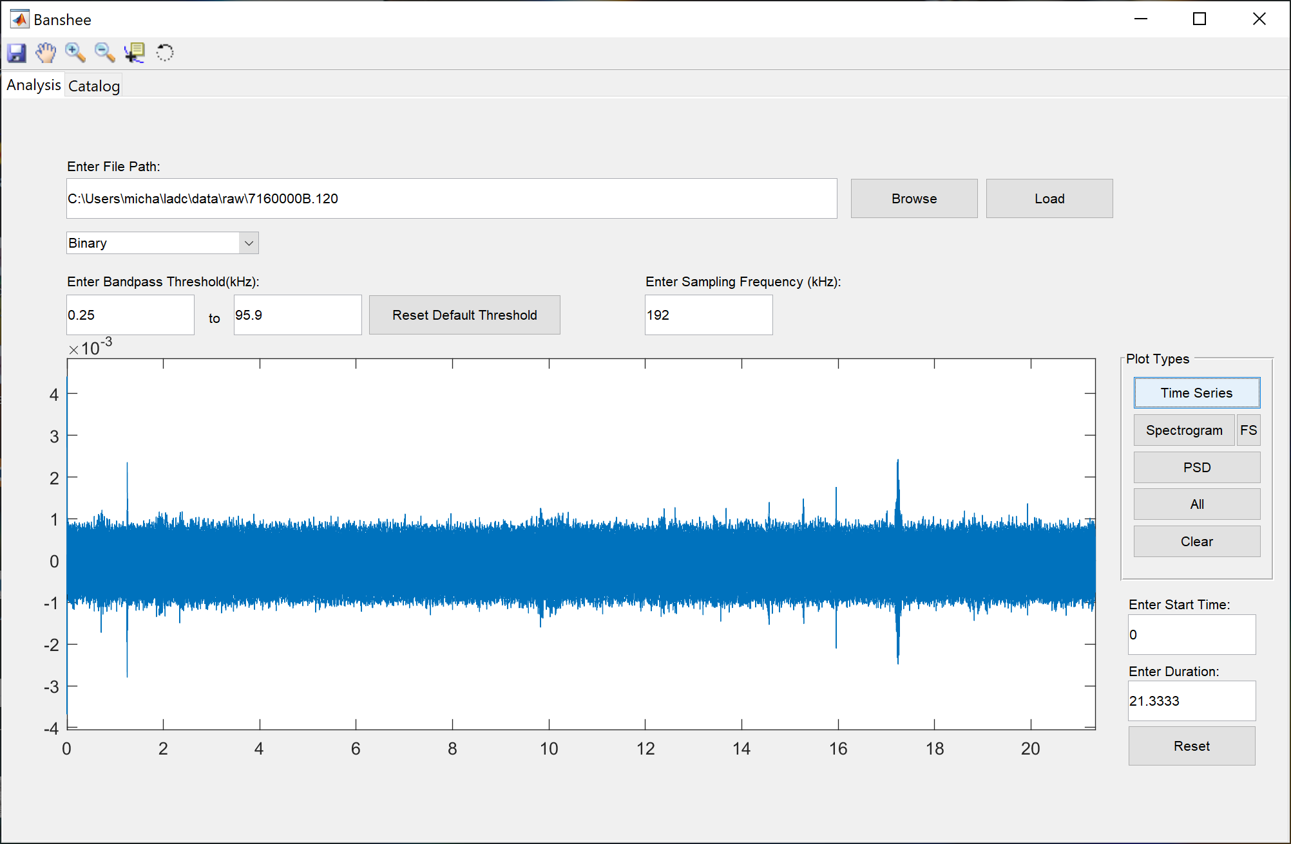
2015 Data
2015 data is available through an FTP connection to ULL
2015 (and 2017) data have ULL detections database
How to access this data easily?
Obtain files
Read files

Slide 5
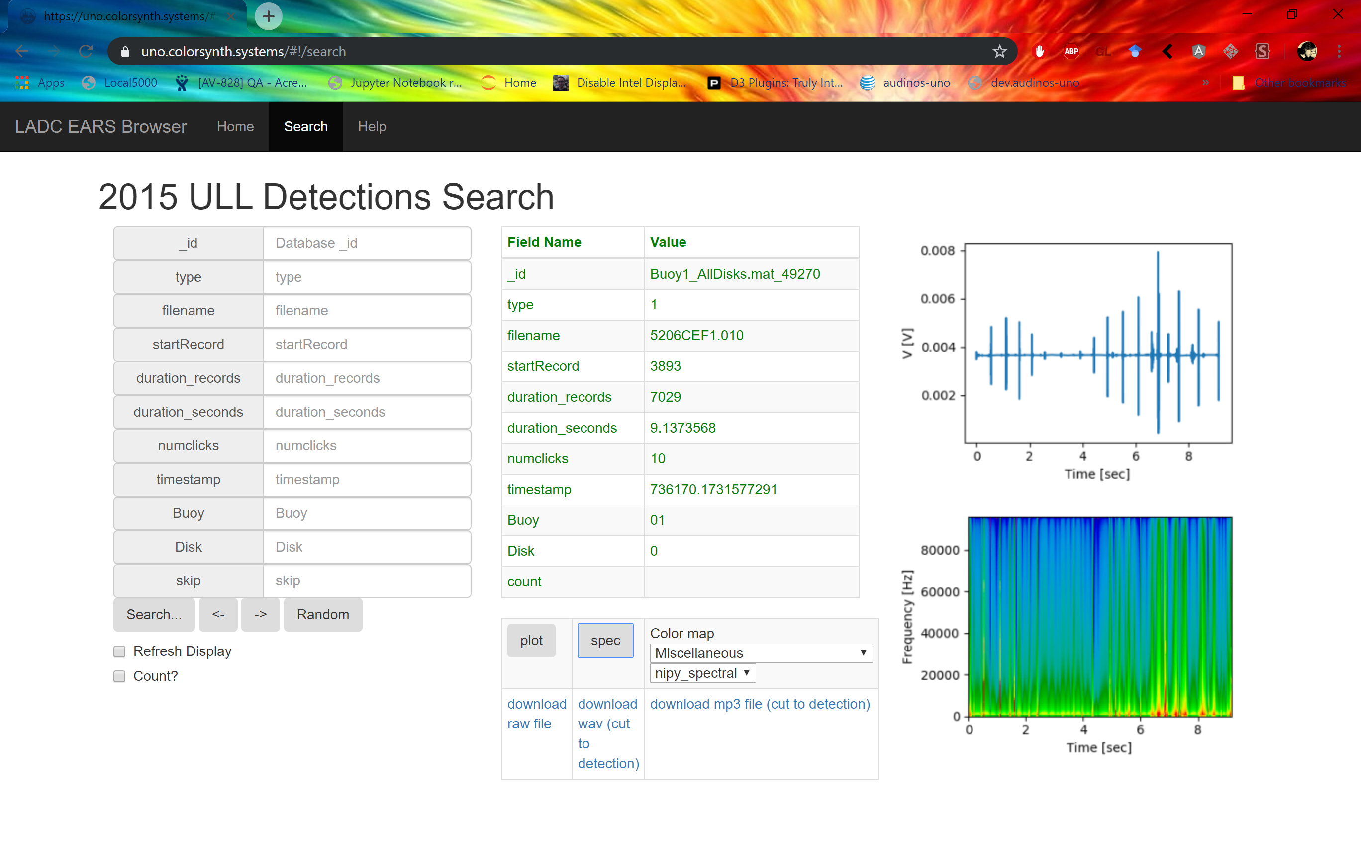
Live site

Slide 6
2017 Data
Obtained multiple hard drives with ~20TB of files
How to access?
How to obtain files
How to read (same as 2015)
Want some helper functions around cleaning the data…

Slide 7
Python package
import unophysics as uno
Then everything is easy.
Python uses pip
In order to install library, library needs to be in particular form
Then, made public on pypi
Can ‘pip install unophysics’

Slide 8
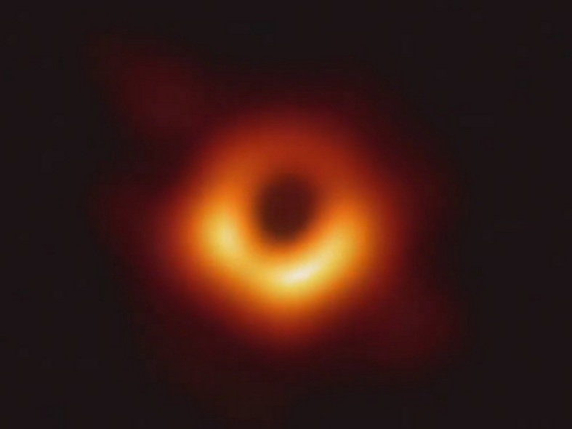
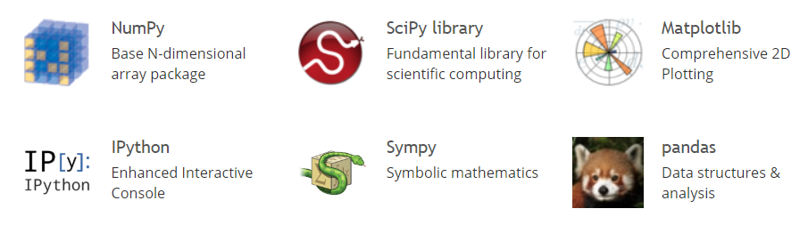
Aside: FOSS and Open Scientific Computing vs. other alternatives
Python + scientific stack
Produces good, correct results
Used by NASA and many others
All free software
All open source
Created by many thousands of people
Enables actual reproducible science
MatLab + Mathematica Etc.
Produces good, correct results
Used by NASA and many others
Costs money (sometimes a lot!)
Can’t usually see source
Hard to share

Slide 9
Notebook demo

Slide 10
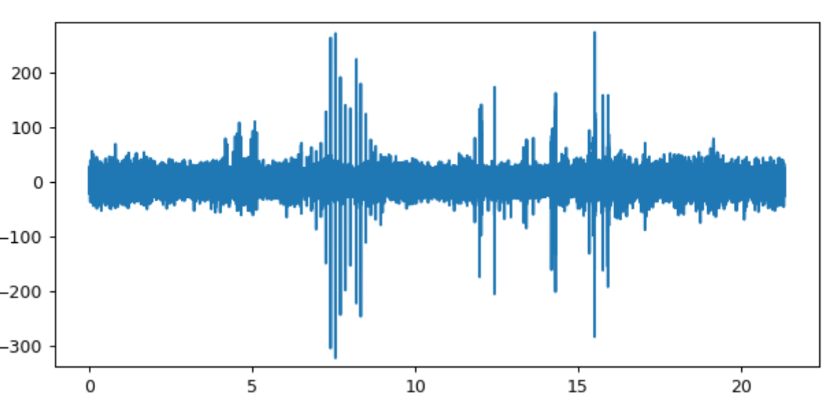
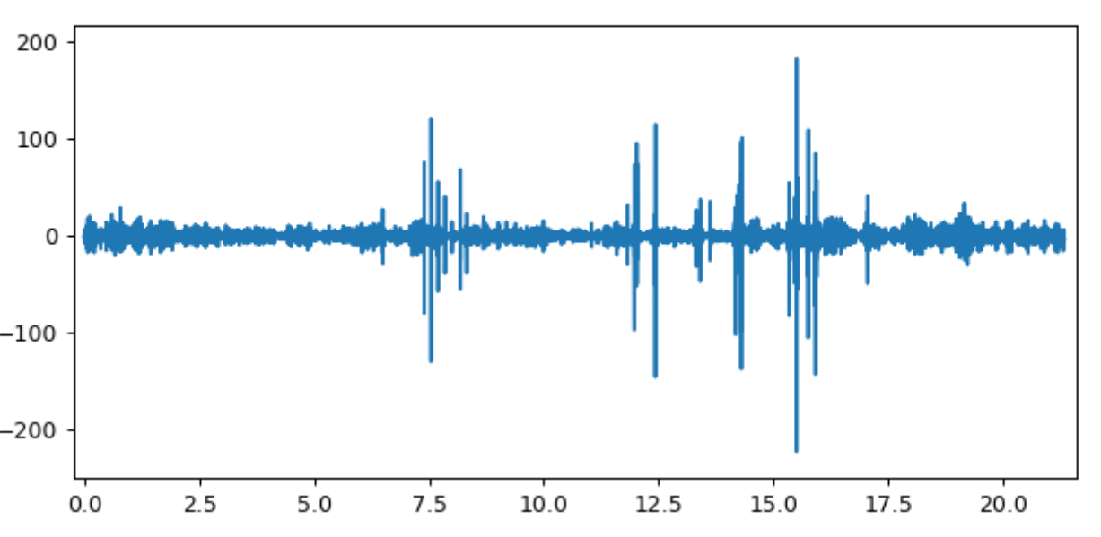
Clean data
Data is noisy.
Want to remove noise.

Slide 11
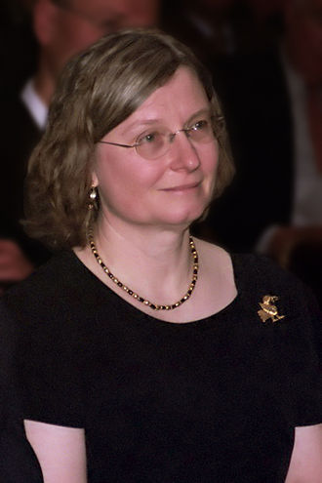
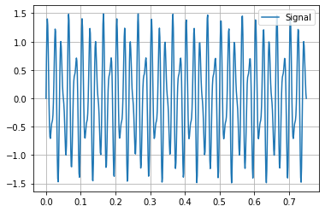
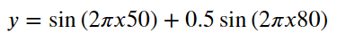
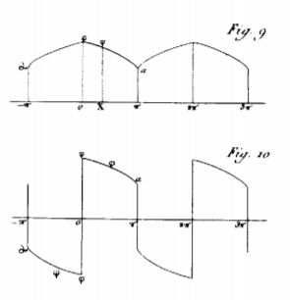
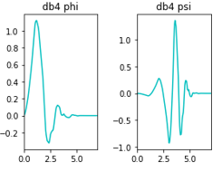
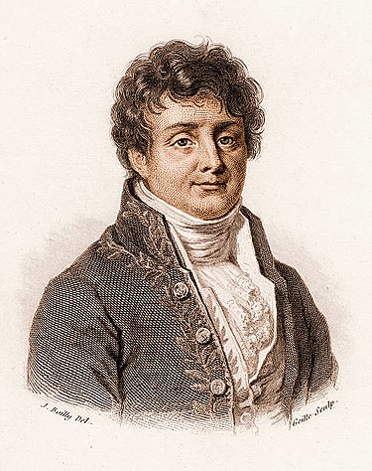
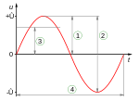
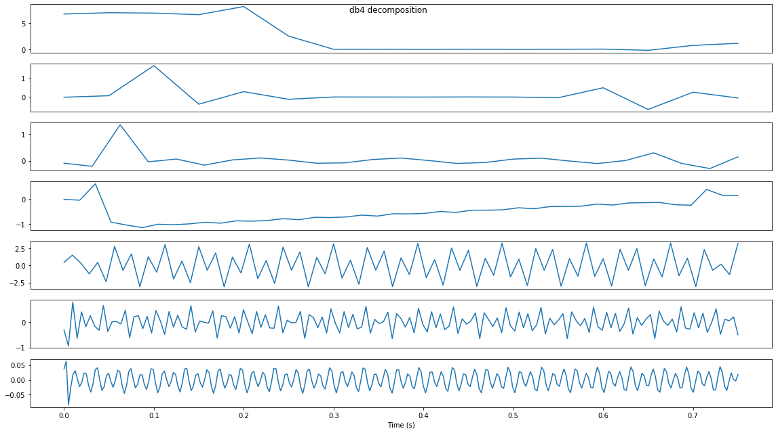
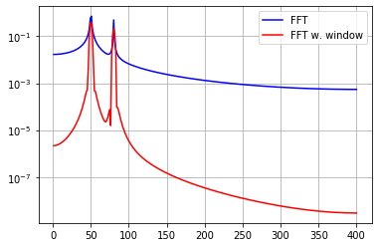
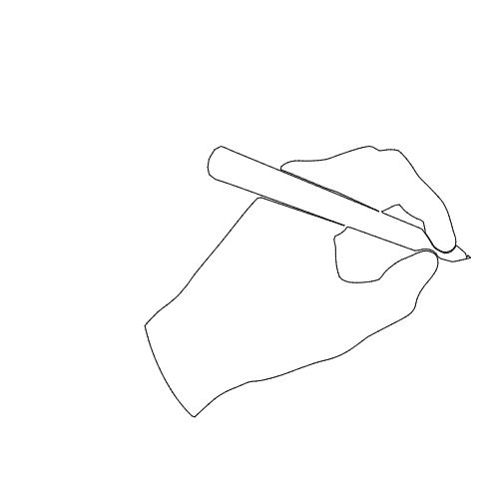
Wavelet Analysis
What is a wavelet?
How is it related to Fourier transform?
W()
Ingrid Daubechies
F()
Joseph Fourier

Slide 12
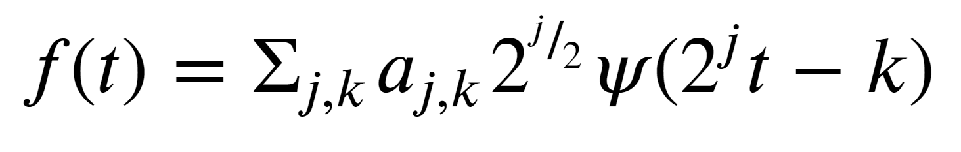
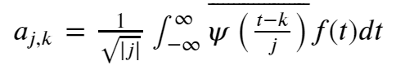
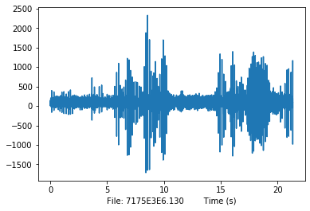
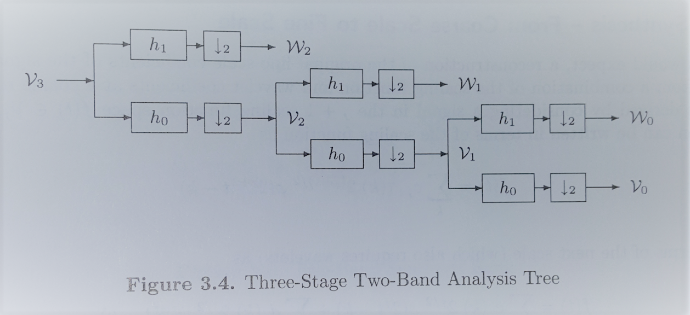
Some wavelet theory
Function can be represented:
Integral to find coefficients:
Or… filter banks:

Slide 13
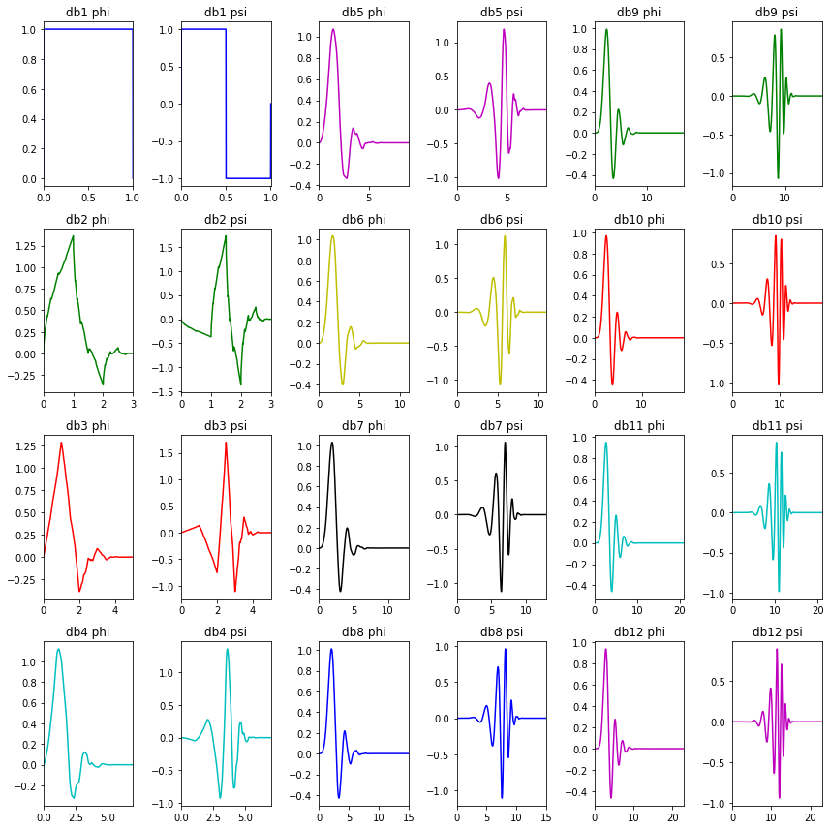
Some wavelets
Graph phi, psi
Daubechies family
db1 == Haar

Slide 14
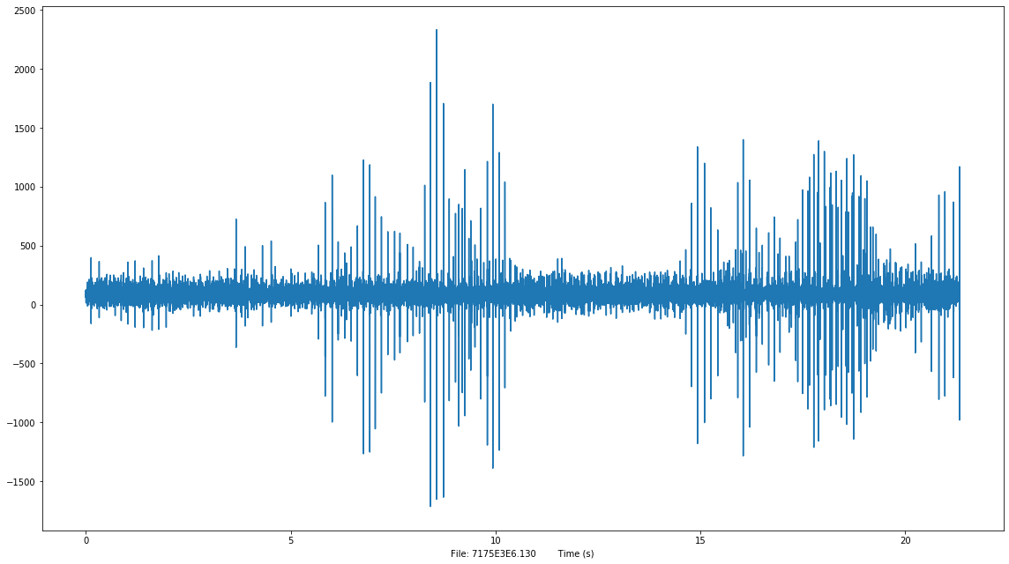

Slide 15
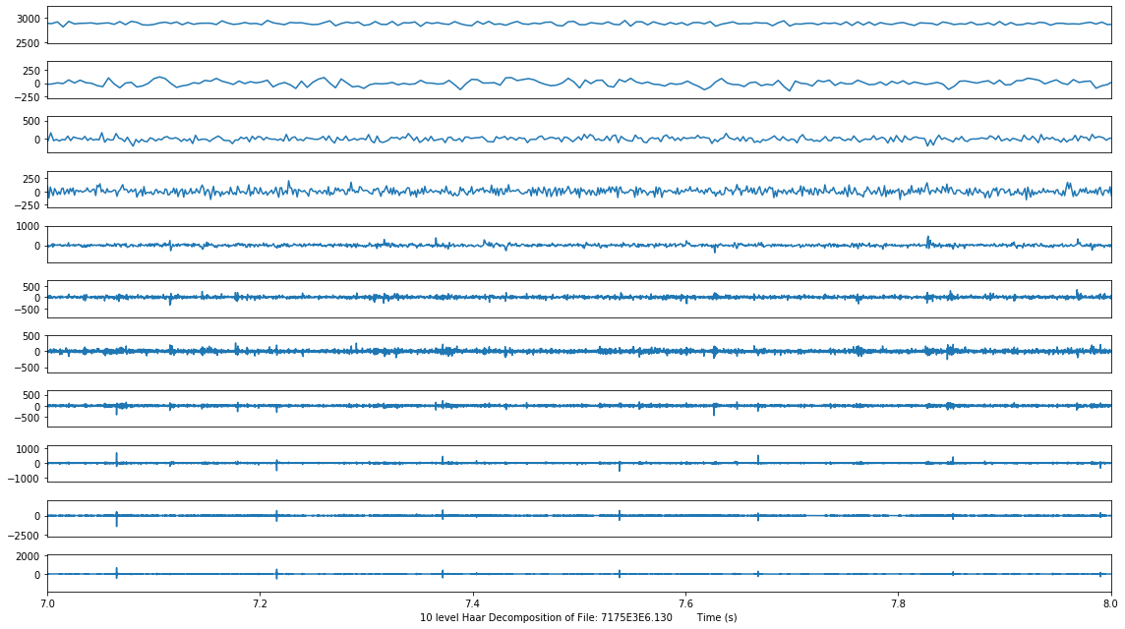

Slide 16
Wavelet denoising
What is it?
Throw away the bad, keep the good.
Throw away by thresholding.
Why It should work.
Wavelet transform “spreads” noise.
Some graphs to explain.
Into unophysics
uno.wavefuncs.wave_clean(data)

Slide 17
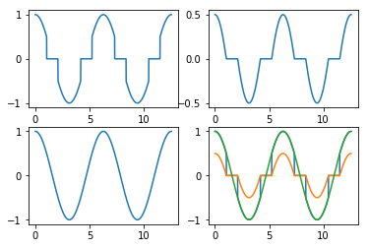
Thresholding for denoising
Effect of varying threshold:
Top: soft
Bot: hard
Effect of thresholding on cos
TL: hard TR: soft
BL: orig BR: all

Slide 18
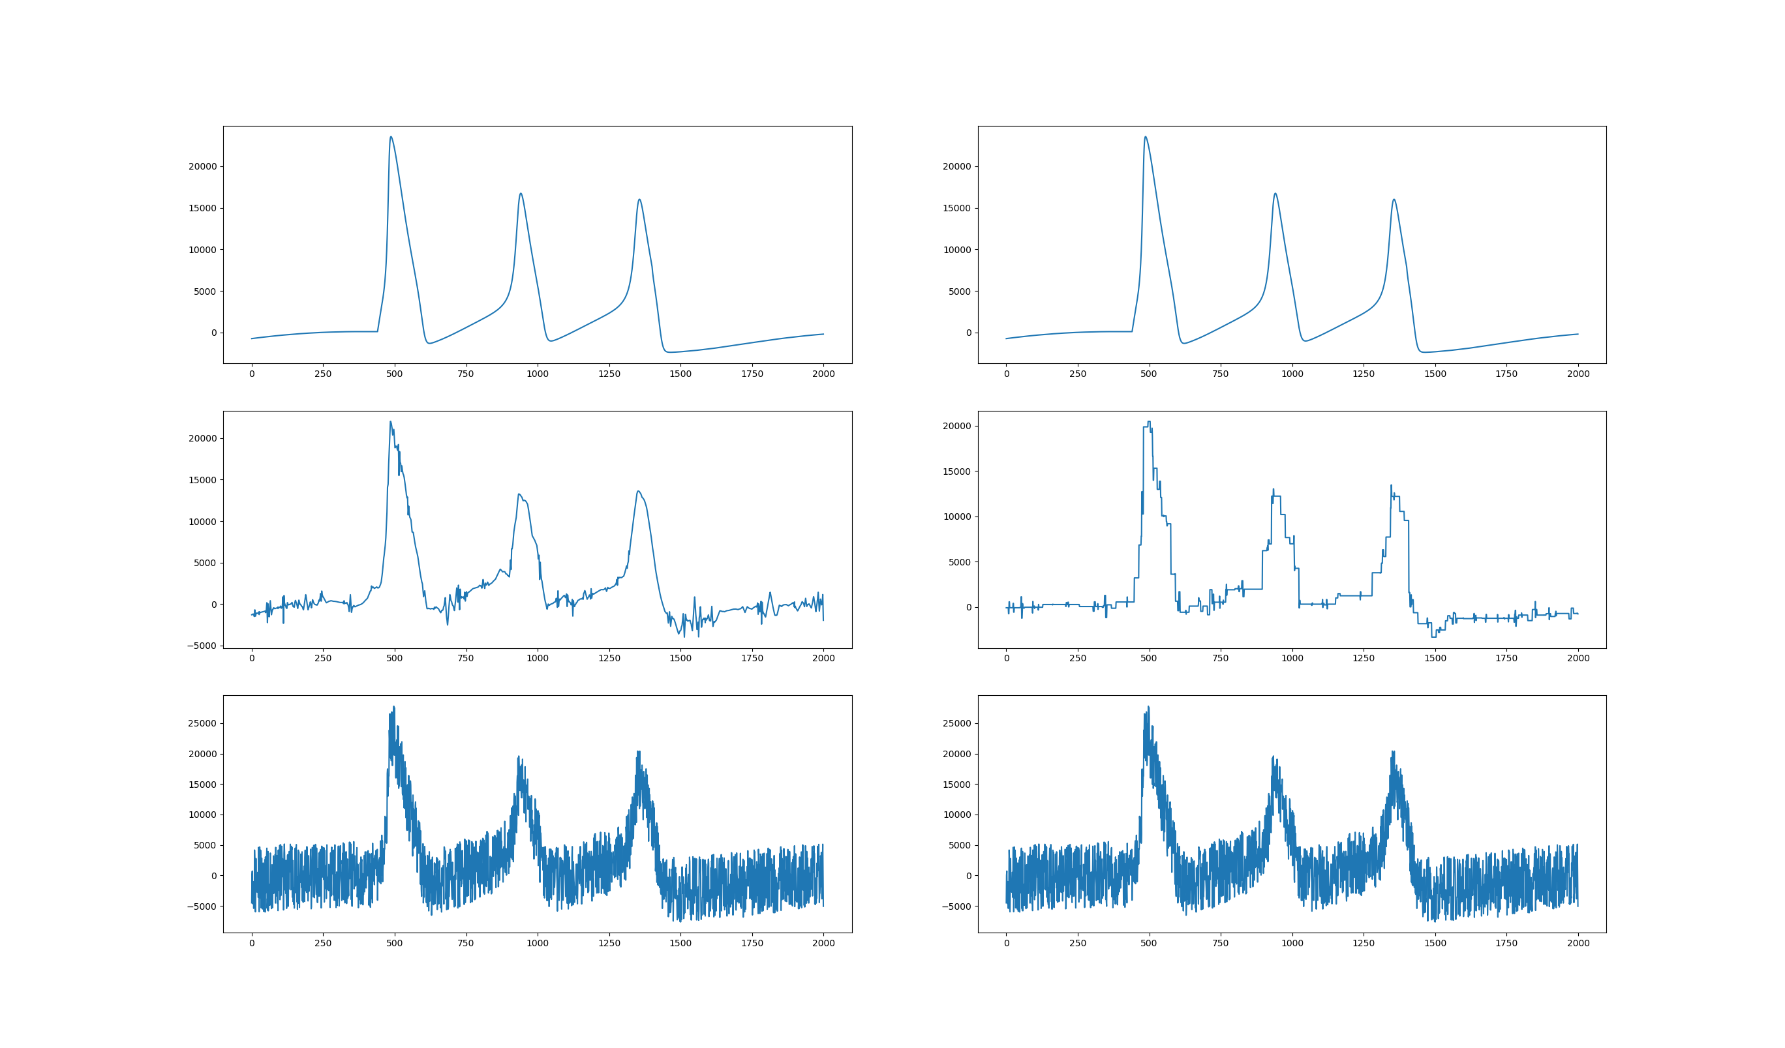
Thresholding results – RBIO5.5 vs. Haar Simulated Nerve Signal, noise added
RBIO5.5
Haar/db1
Original
Denoised
Noised
Zoomed in, 3 spikes visible

Slide 19
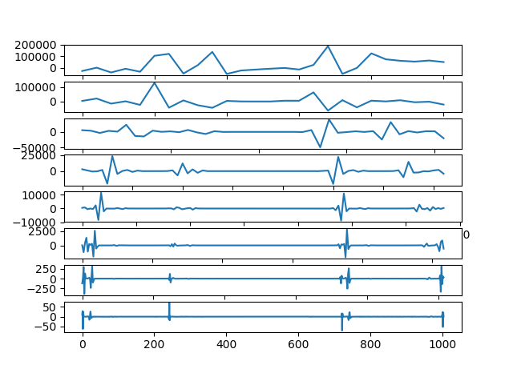
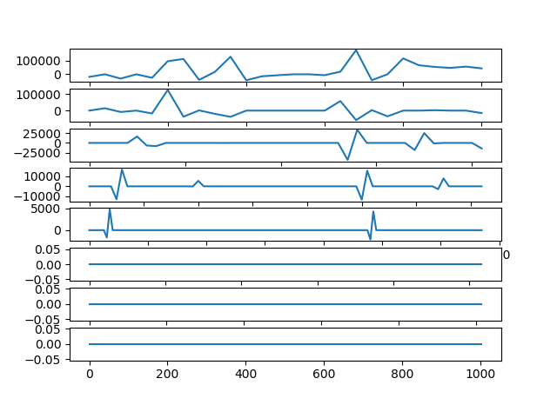
Wavelet decomposition (simulated - Clean)
Not Thresholded
Thresholded

Slide 20
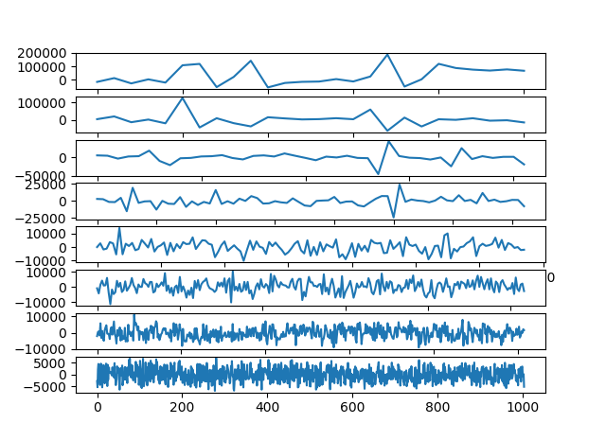
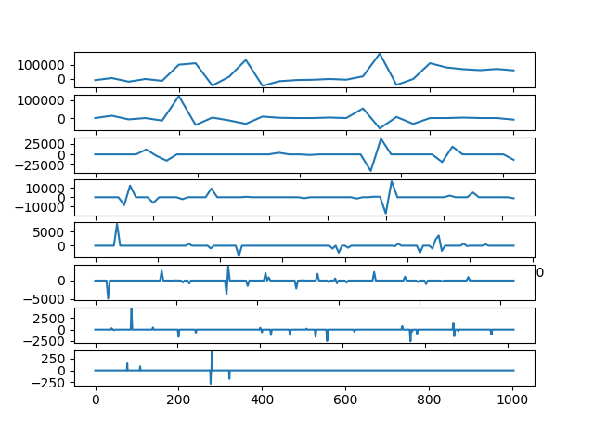
Wavelet decomposition (simulated - Noisy)
Not Thresholded
Thresholded

Slide 21
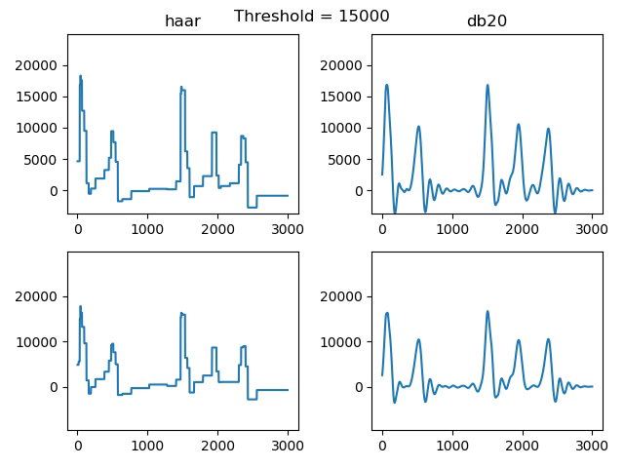

Slide 22
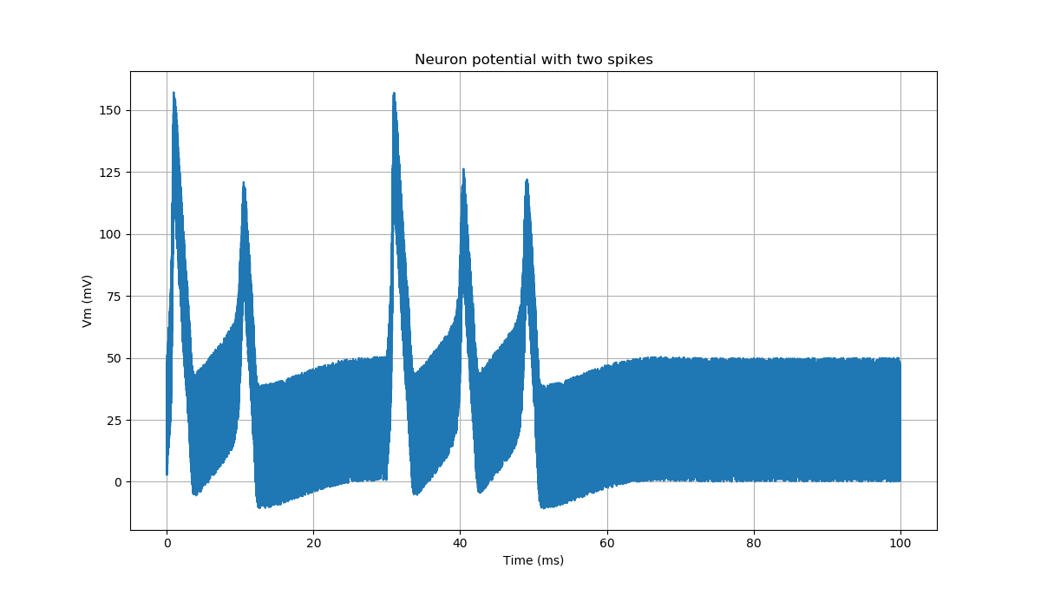
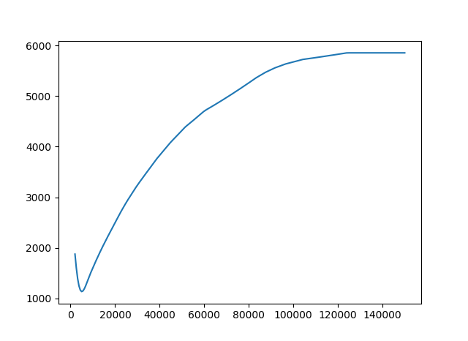
Thresholding ideas:
Create simulated waveform
Add noise
For each wavelet:
For range of thresholds:
Compute thresholded waveform
Compute RMS error compared to original clean waveform
Plot
Chose soft from early initial testing, should investigate more in future
Simulated data + noise
Threshold curve for Haar

Slide 23
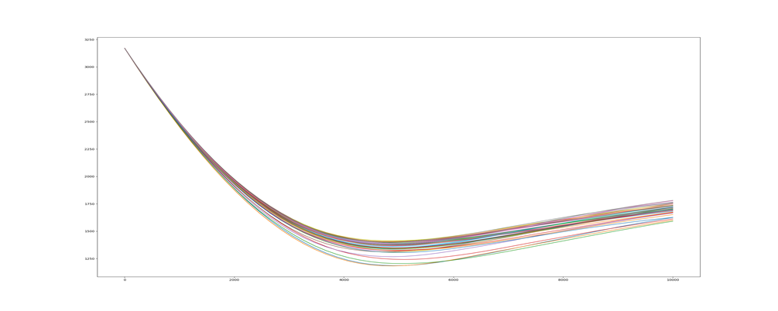
Wavelets tested
Biorthogonal (15)
Reverse Biorthogonal (15)
Coiflet (17)
Daubechies (38)
Symlets (19)
Meyers FIR (1)
Haar (1)

Slide 24
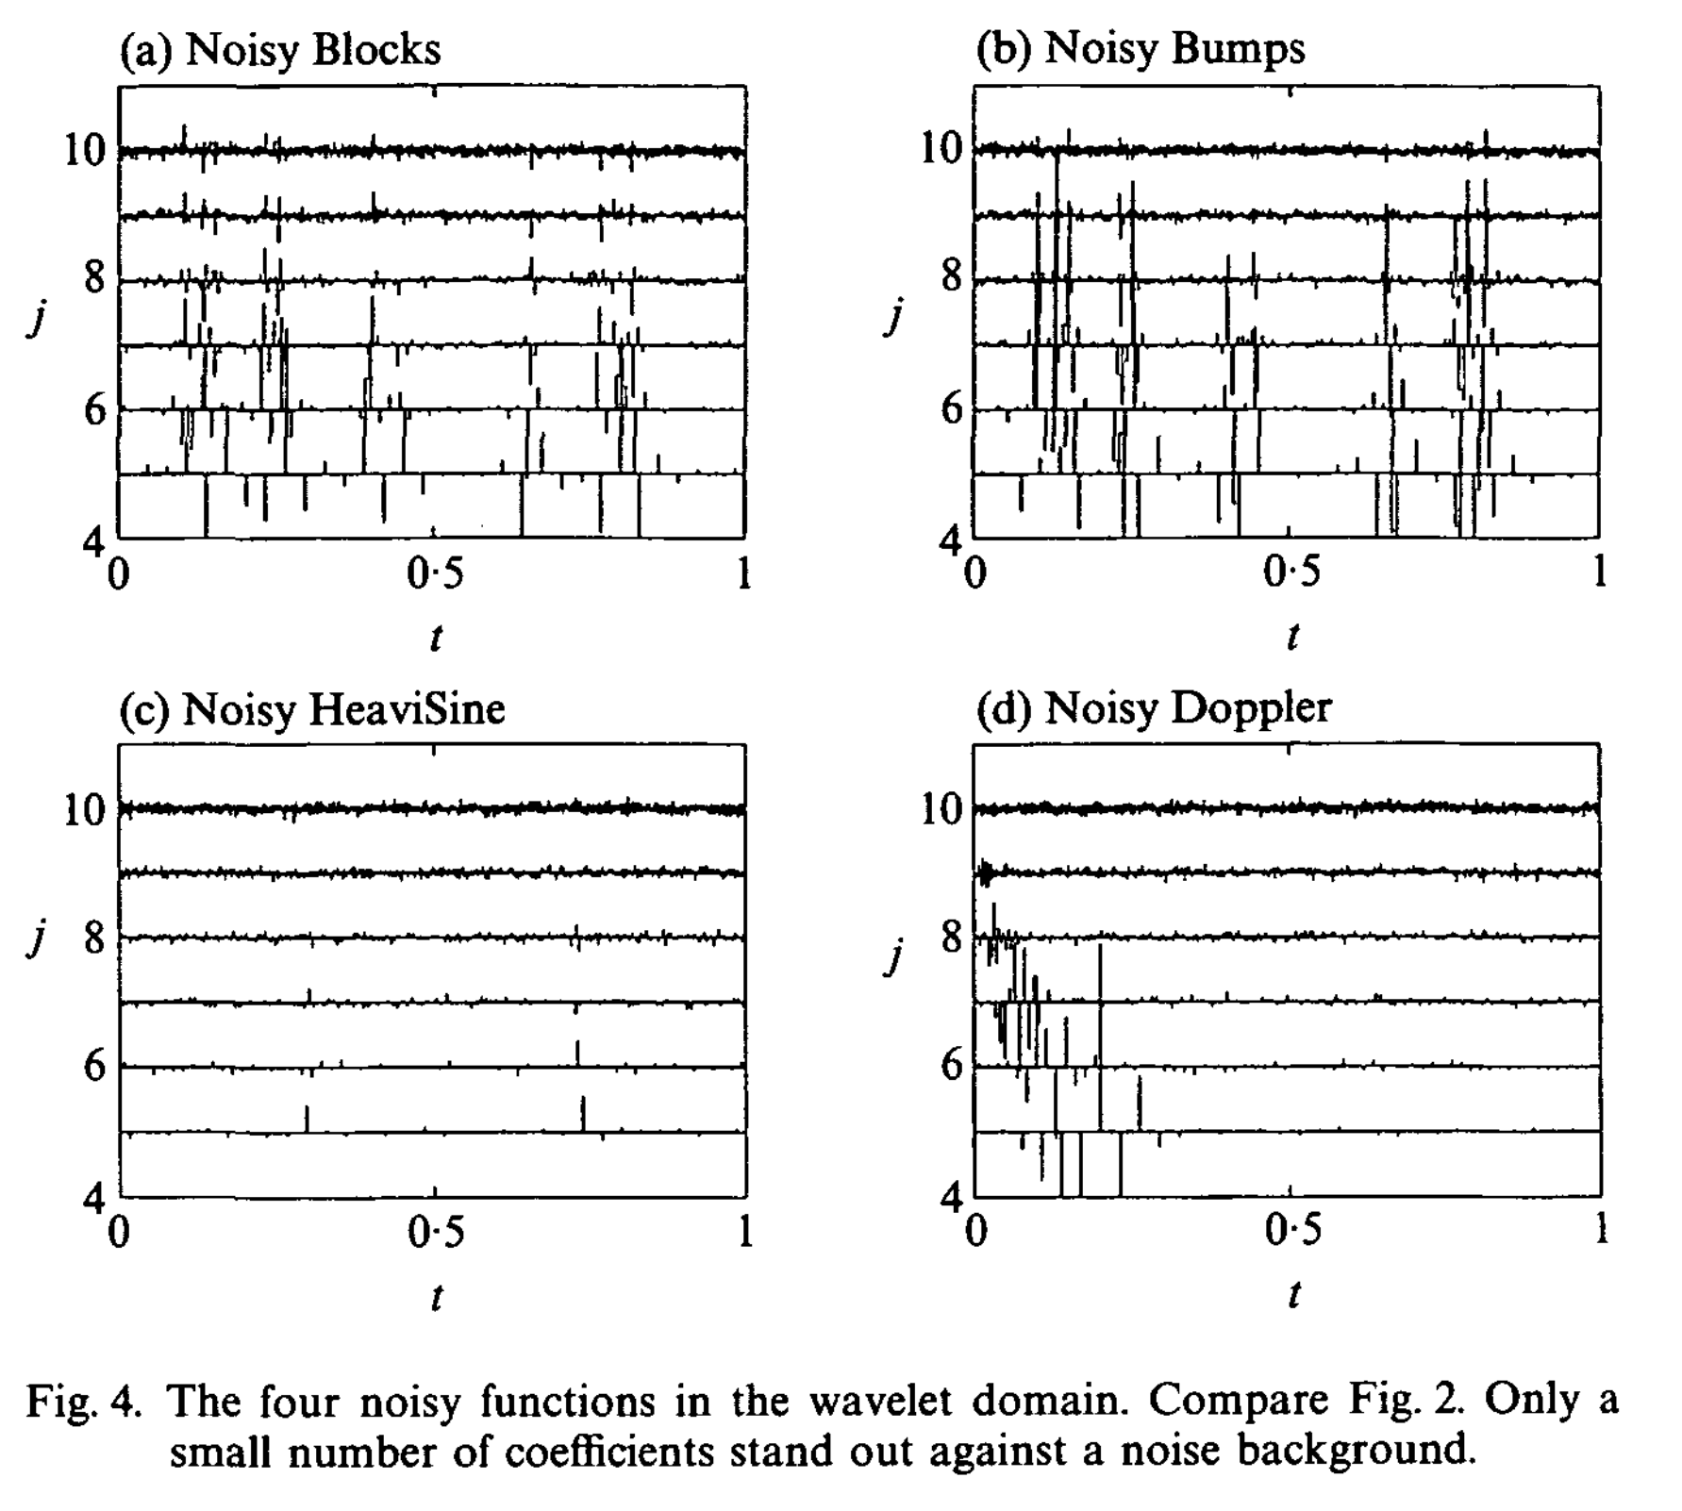
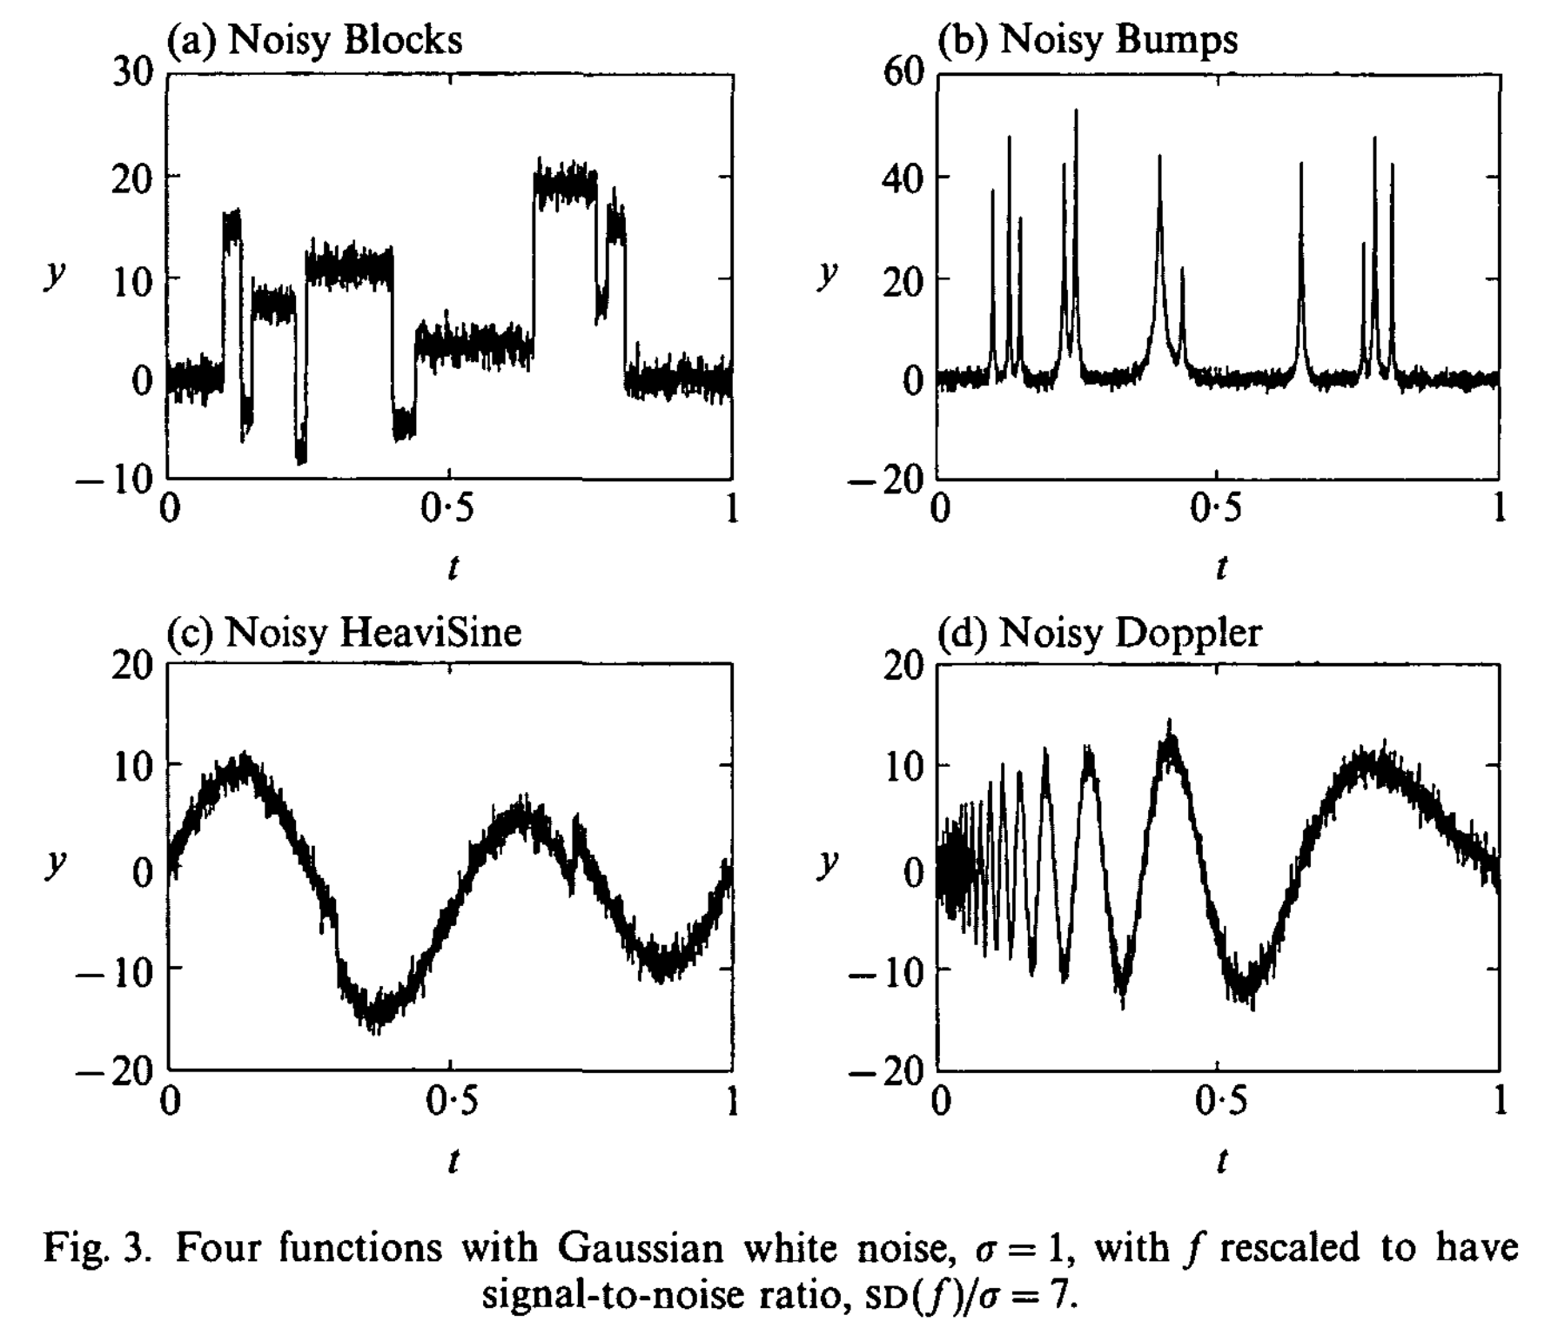
Automatic thresholding choice
Paper by Donoho and Johnstone:
Ideal Spatial Adaptation via Wavelet Shrinkage

Slide 25
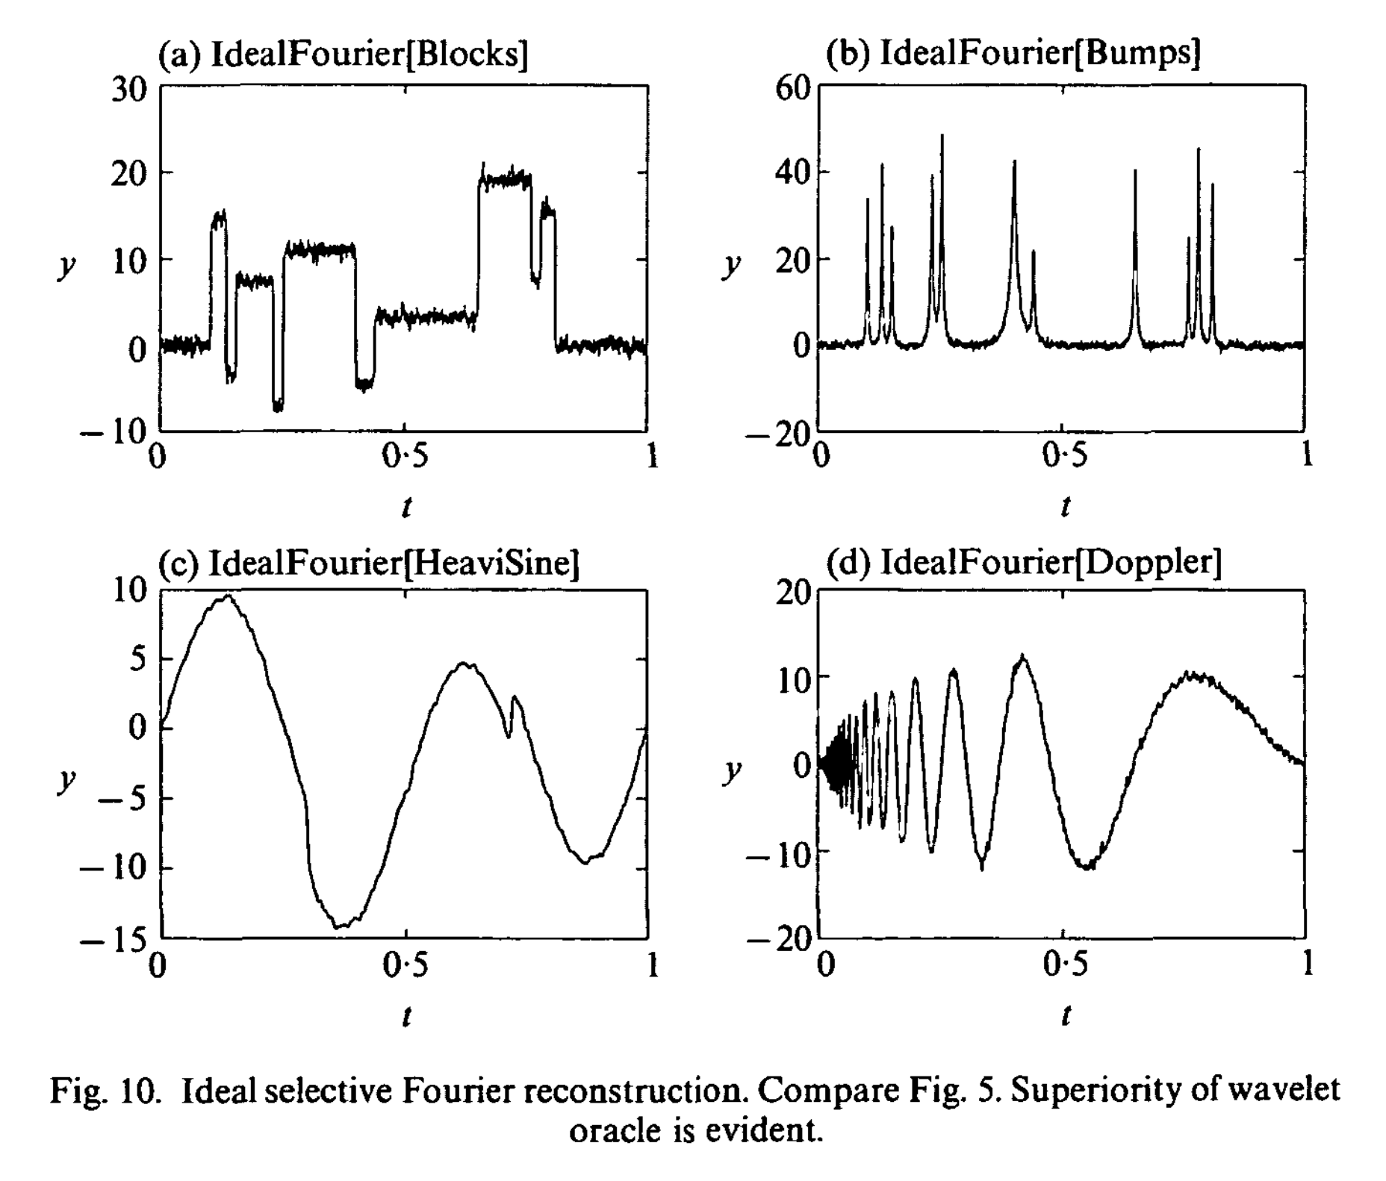
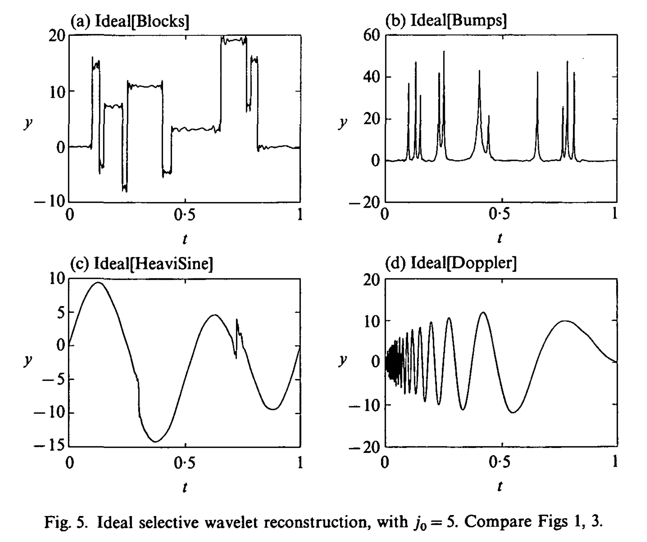
Fourier vs. Wavelets

Slide 26
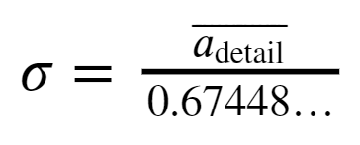
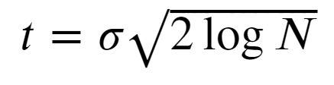
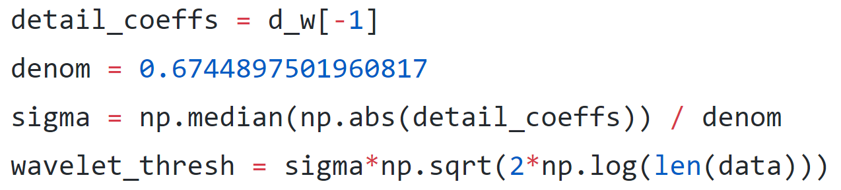
How to choose, VisuShrink:
Use the median absolute deviation of the most detailed wavelet coefficients to find estimate of the noise and then normalize to the length of the data.
Note: 0.67448… is the 75th quantile of the underlying noise distribution ppf, assumed Gaussian here.

Slide 27
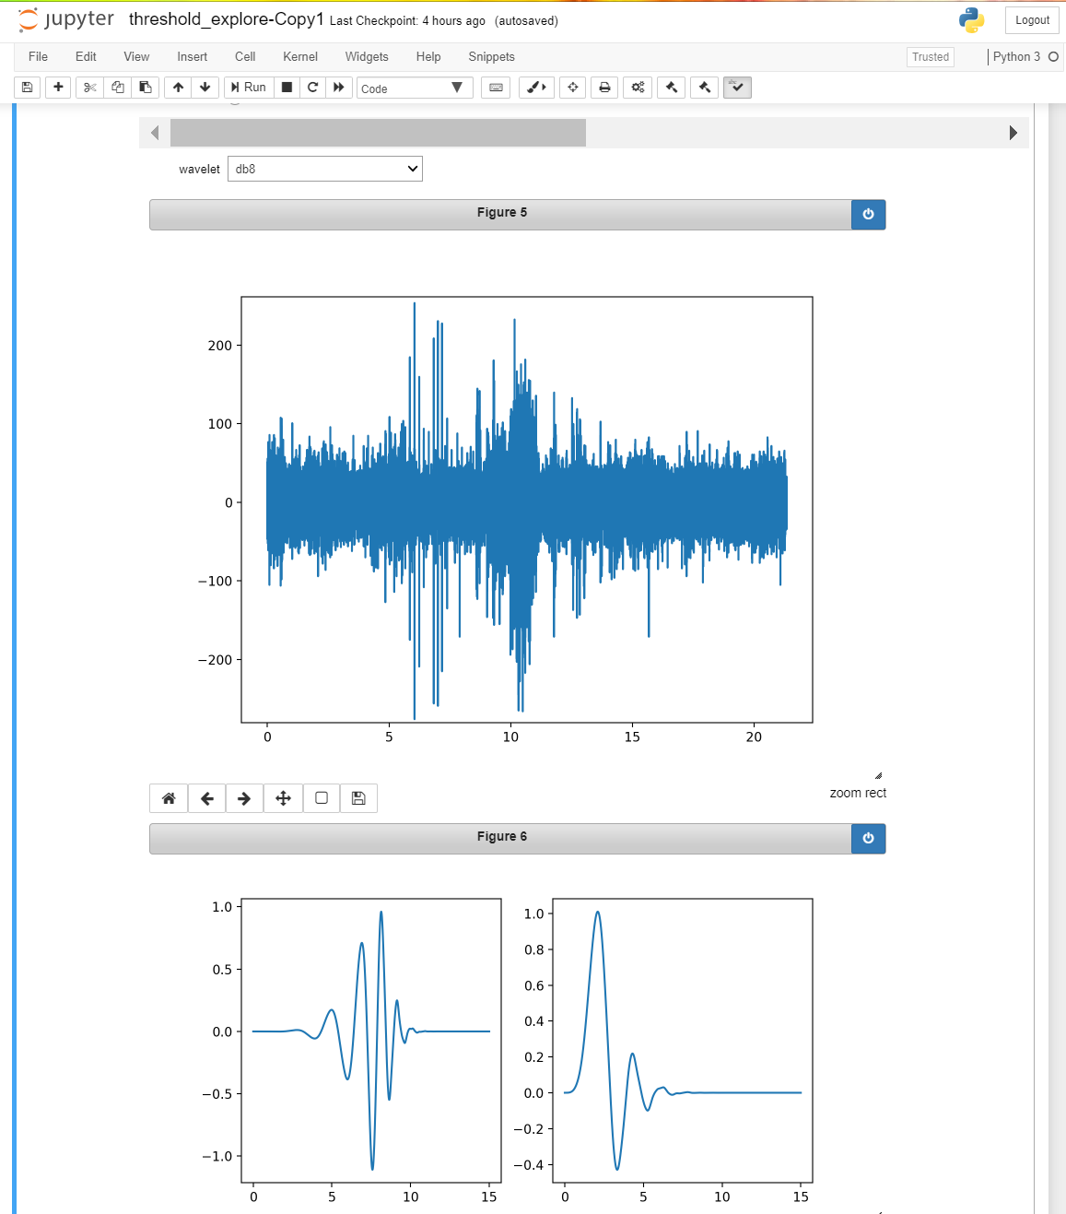
Notebook demo

Slide 28
Work in progress – automatic finding algorithm
Problem:
Want to find lots of small “interesting” parts of files in large swaths of nothing.
General idea:
Get 𝑁_{𝑓𝑖𝑙𝑒𝑠} of interest from ULL detection database
For each file in files:
Split into 𝑁_{𝑠𝑝𝑙𝑖𝑡} pieces
For each piece:
Apply wavelet shrinkage algorithm to clean noise
Apply "quick" estimator
If frequency of interest found:
fft based power/energy calculation
If power in frequency band of interest:
If file "small" enough, or "other" good enough criteria:
add to interesting file peice list
ElseIf not small enough:
split into 𝑁_{𝑠𝑝𝑙𝑖𝑡} and start back at estimator stage
Else:
toss file peice
Else:
toss file peice

Slide 29
Flow chart of algorithm
Full file
Split file
Split file
Split file
Split file
Split file
Quick Estimate
yes
no
FFT
no
Split file again
end
Small enough?
no
yes
end
Keep it!
yes

Slide 30
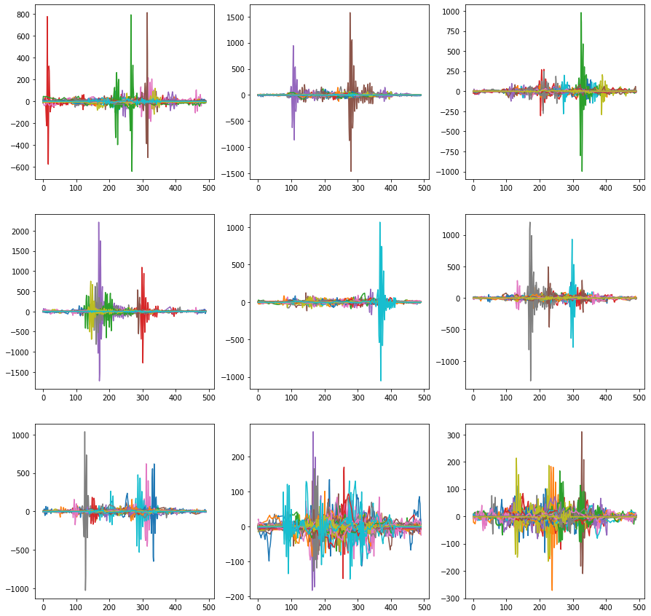
Notebook demo

Slide 31

(WIP) Clustering Algorithm From LIGO Black Hole Merger Search
LIGO related paper showing a technique for clustering on time-frequency plots to find transient signals
Algorithm consists of 4 steps
create a time-frequency plot
can use any 1D data to 2-D TF algorithm, STFT (with or without filter), wavelets, etc. The analysis was all done with STFT, no window; but they mention that in practice they all should be valid to a certain degree.
threshold pixels, resulting in 0,1
cluster pixels
they use geometric clustering based on strength of neighbors
threshold clusters on total power in cluster
these results are the signals of interest
Example from the paper:

Slide 32



Notebook demo

Slide 33
Thanks:
My partner, Rachel for putting up with me for these years while I code all night.
Dr. Ioup for always believing in me and encouraging me to continue.
My family, parents and others who have helped throughout, both financially and emotionally.
The open source community, none of this would be possible without years of volunteer contributions.

Slide 34
references
Proceedings of the LADC-GEMM 2017 Gulf of Mexico Experiment, LADC-GEMM
Banshee GUI Reference Code; Britt Aguda, Kirk Bienvenu
Donoho and I.M. Johnstone. Ideal Spatial Adaptation via Wavelet Shrinkage. Biometrika. Vol. 81, No. 3, pp.425-455, 1994. DOI:10.1093/biomet/81.3.425
Gregory R. Lee, Ralf Gommers, Filip Wasilewski, Kai Wohlfahrt, Aaron O’Leary (2019). PyWavelets: A Python package for wavelet analysis. Journal of Open Source Software, 4(36), 1237, https://doi.org/10.21105/joss.01237.
Hodgkin, A. L.; Huxley, A. F. (1952). "A quantitative description of membrane current and its application to conduction and excitation in nerve". The Journal of Physiology. 117 (4): 500–544
Introduction to Wavelets and Wavelet Transforms, BGG
Spectral Analysis of Signals, Stoica/Moses
Théorie analytique de la chaleur, Joseph Fourier, 1822
10 Lectures, Daubechies
Wavelets and Filter Banks, Strang/Nguyen
The Fourier Transform and its Applications, Bracewell
The World According to Wavelets, Barbara Burke Hubbard
https://docs.scipy.org
Etc. (more available upon request), e.g. myriad Wikipedia articles for both reference finding and images

Slide 35



What?
Try to remove noise from extracellular recordings of neural action potential waveforms (spike trains) with the least amount of distortion of the original shapes.
Try wavelet denoising techniques and develop ideas about how to improve this.

Slide 36

What is a neural spike?
“Action potential”
Neural conductance model
Information carrier of brain
Activates muscles
Transmits sensor info
“Integrate and fire” idea implies spikes
Neuron, synapse, dendrite, axon
100 Billion neurons in human brain
100 Trillion connections

